Slide 1
Fiscal Year 2016
Cape Elizabeth Municipal Budget

Slide 2
Budget Topline
Budget is up 6.3%
Property Tax would increase 27 cents
This increases each tax bill 1.56%.
Library is half of the Increase

Slide 3
Personnel
Personnel Costs are 51% of the Budget
Most employees would receive a 2.5% increase
Health insurance costs are up $40,400 due to changing demographics
Workers compensation costs are up $30,000 or 31% due to change in experience modification
$35,000 is included for 50% of the cost of an human resources assistant to be shared with the school department.

Slide 4
Library Debt Service
Budget contains $290,000 in new debt service expenses for the Thomas Memorial Library.
The actual costs will be $306,904. The difference is due to a slightly earlier borrowing than anticipated.
The true interest costs for the library project is 2.42%
The debt is $4.0 million with interest of 1.26 million
The debt will be fully paid on March 15, 2035.

Slide 5
Miscellaneous Increases
$15,000 for retirement costs
$15,000 for greenbelt trails encroachment
$12,000 for geographic information systems
$10,000 for facilities maintenance
$10,000 for legal services
$5,000 for street lights

Slide 6
Capital Needs
Identified need was $1.5 million
Long term financial plan projected $1.0 million as part of $100,000 increase each year
Budget provides for $950,000 or $50,000.
Hope to bridge difference with savings in retirement costs

Slide 7
Proposed Capital Funding
$435,000 for roadway paving and drainage needs
$180,000 to replace a front end loader
$66,000 to replace two police cruisers
$40,000 for a pick up truck replacement
$30,000 for bodywork to a fire truck
$32,000 for high school tennis court repair

Slide 8
Revenues
$100,000 more from excise taxes are citizens are buying newer more expensive vehicles
$21,754 decline in state revenue sharing to $430,000.
Governor has projected no revenue sharing for FY 2017.

Slide 9
Budget Review
Municipal Budget on March 16 and March 18
School Budget on April 27
Budget public Hearing on May 12
Citizen Vote on school budget on June 9th.

Slide 10
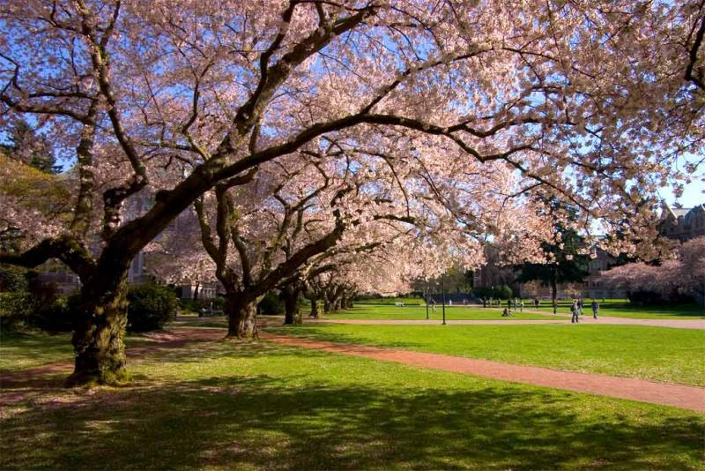
Spring is Budget Season

